Slide 1
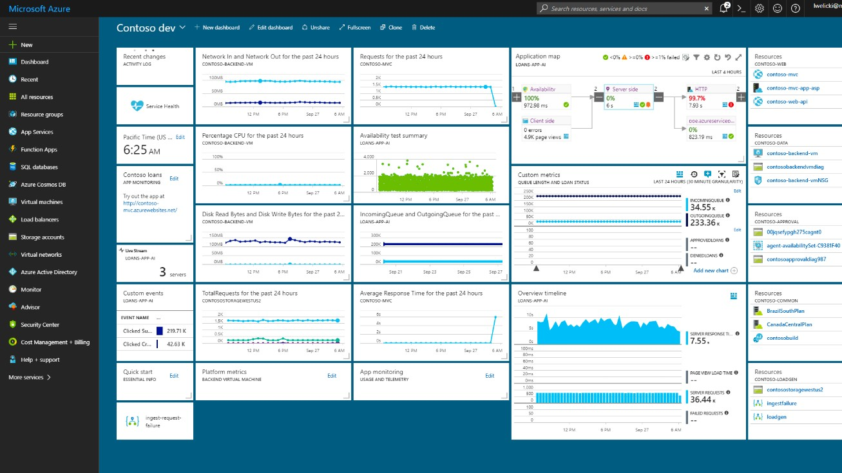

Azure Student Dev Camp
KCCITM, Greater Noida
On 25/09/2019

Slide 2

Loveneesh Dhir
2nd Year CSE Student, An ML Enthusiast
GitHub Campus advisor at KCCITM
Microsoft Student Partner at KCCITM
LinkedIn - https://www.linkedin.com/in/loveneesh-dhir-98356b170

Slide 3
Agenda
Introduction to Cloud Computing and Microsoft Azure
Build with Azure App Services with GitHub
Experiment with Artificial Intelligence & Machine Learning
Connect with Microsoft during your student career

Slide 4

Opportunity and Responsibility

Slide 5



Cloud: Massive power for everyone
Scalability
Affordability
Flexibility
Massive available compute
Massive available datasets
Scale up and down
No need to buy hardware
Use it only when you need it
Use your preferred platforms

Slide 6
Linux
Python
Java
node.js
Docker
Android
And many more …
About
50%
of Azure VMs run
Linux4
With Azure, you have choices

Slide 7





















95%
of the Fortune 500 use Azure5

Slide 8
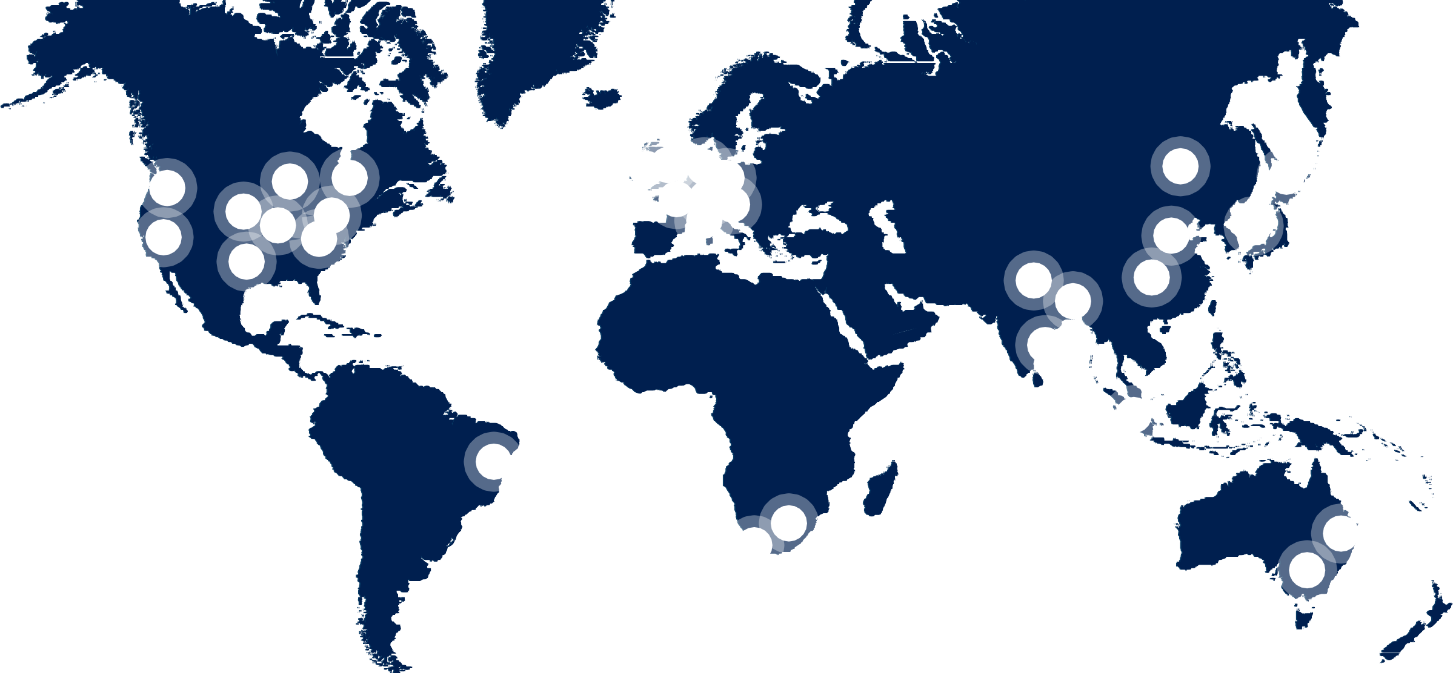
53Azure regions6

Slide 9

































Azure: The trusted cloud
ISO 27001
ISO 27018
ISO 27017
ISO 22301
SOC 1 Type 2
SOC 2 Type 2
SOC 3
CSA STAR
Self-Assessment
CSA STAR
Certification
CSA STAR
Attestation
Moderate
JAB P-ATO
High
JAB P-ATO
DoD DISA
SRG Level 2
DoD DISA
SRG Level 4
DoD DISA
SRG Level 5
SP 800-171
FIPS 140-2
Section 508
VPAT
ITAR
CJIS
IRS 1075
PCI DSS
Level 1
CDSA
MPAA
FACT UK
Shared
Assessments
FISC Japan
HIPAA/
HITECH Act
HITRUST
GxP
21 CFR Part 11
MARS-E
IG Toolkit UK
FERPA
GLBA
FFIEC
Argentina | EU | UK | China | China | China | Singapore | Australia | New Zealand | Japan My | ENISA | Japan CS | Spain | Spain | India | Canada | Privacy | Germany IT
PDPA | Model Clauses | G-Cloud | DJCP | GB 18030 | TRUCS | MTCS | IRAP/CCSL | GCIO | Number Act | IAF | Mark Gold | ENS | DPA | MeitY | Privacy Laws | Shield | Grundschutz workbook

Slide 10


$133,000
Data scientist annual pay (US
Cloud and distributed computing:
Average2
1
$132,000
Average3
#1 skill of 2018
AI engineer annual pay (USA):

Slide 12
Agenda
Introduction to Cloud Computing and Microsoft Azure
Build with Azure App Services with GitHub
Experiment with Artificial Intelligence & Machine Learning
Connect with Microsoft during your student career

Slide 13





Meet Azure App Services
Web Apps
Build, deploy, and scale fast. Supports Windows or Linux.
Mobile Apps Build for iOS, Android, and Windows
Web Apps for
Containers
Deploy containerized
versions of your app
API Apps
Build and consume APIs in the Cloud

Slide 14
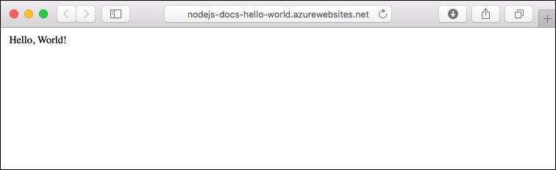
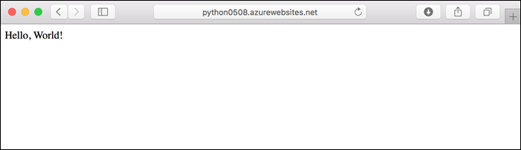
It’s really that easy.

Slide 15
Build and scale with the cloud
Inactivity
Period
t
t
On and Off
On & off workloads (e.g. batch job)
Over provisioned capacity is wasted
Time to market can be cumbersome
Unpredictable Bursts
Unexpected/unplanned peak in demand
Sudden spike impacts performance
Can’t over provision for extreme cases
t
t
Growing Fast
Successful services needs to grow/scale Keeping up w/ growth is big IT challenge Cannot provision hardware fast enough
Predictable Bursts
Services with micro seasonality trends Peaks due to periodic increased demand IT complexity and wasted capacity

Slide 16
So what does “scale up” vs. “scale out”
mean?
Scale Up
Vary the VM size
1 Core w/ 1.75 GB RAM
2 Cores w/ 3.5 GB RAM
4 Cores w/ 7 GB RAM
Scale Out
Vary the VM count
Max 3* instances Max 10 instances
Max 20/50** instances

Slide 17
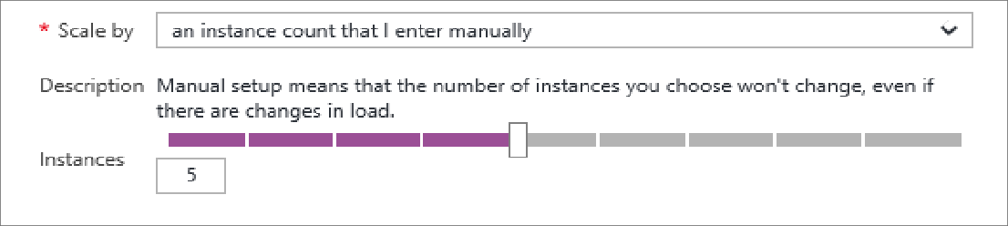
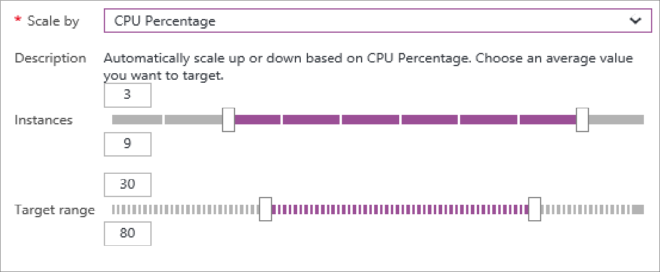
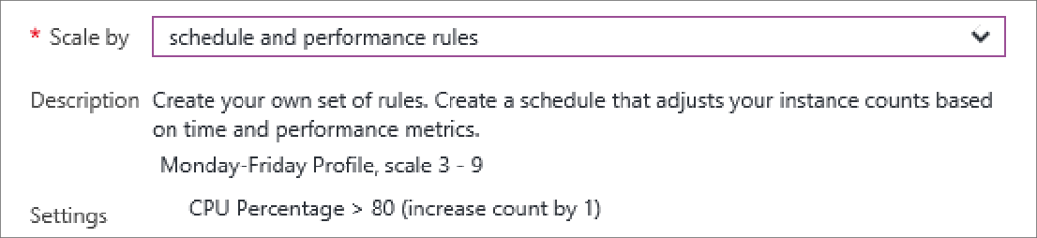
Manual Scaling vs. Auto-Scaling
Manual – Scale via
portal or scripts
Auto – CPU Percentage
Auto – Schedule &
Performance Rules

Slide 18





Deploying your app
Production
5
1
4
Azure DevOps
2
3
Source
Control
Staging
Test
GitHub

Slide 19
Agenda
Introduction to Cloud Computing and Microsoft Azure Build with Azure App Services with GitHub Experiment with Artificial Intelligence & Machine Learning Connect with Microsoft during your student career

Slide 20

Team up. Use your creativity, your passion, and your knowledge of technology to create applications that shape how we live, work, and play.
Microsoft's premier student technology competition
imagine.microsoft.com/usa

Slide 21
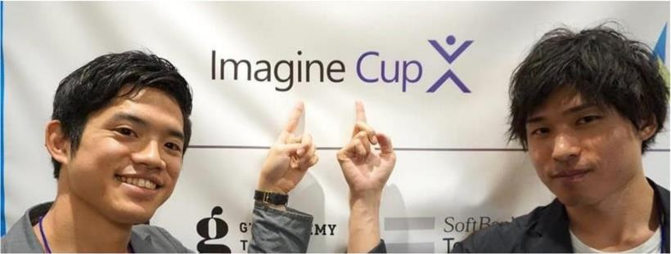
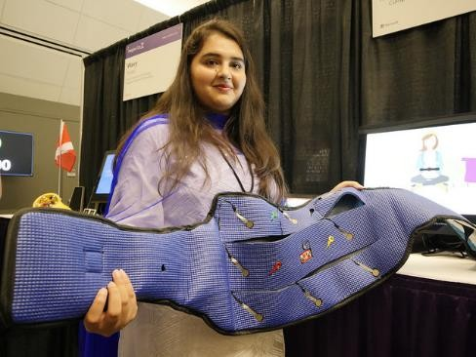

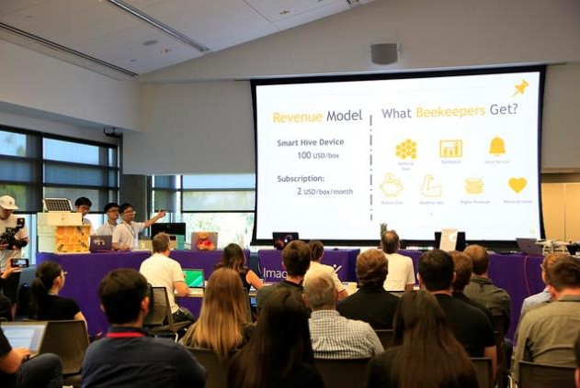
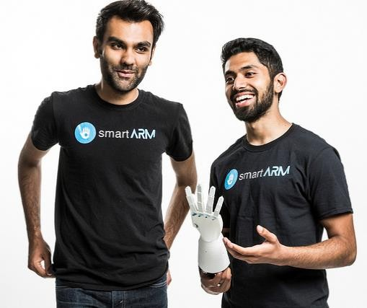
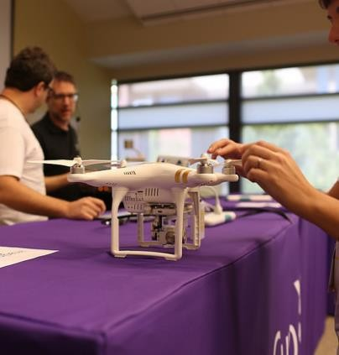

Slide 22




Azure for Students
+
Verify as a student
No credit card required
$100
annual credit
25+
free products
Pay nothing
Ability to convert to pay-as-you-go
for 12 months or until $100 credit is used
aka.ms/azure4students

Slide 23

Take your pick of today’s hands-on lab ^{c}• ^{h}Dªe^{ll}p^{e}l^{n}oy^{g}w^{es}eb: app w Cog Services & GitHub
aka.ms/StudentLabWeb
Predict flights with Azure ML Studio
aka.ms/StudentLabML
Build a neural network with Keras + Python
aka.ms/StudentLabKeras
aka.ms/azure4students (need Azure?)

Slide 24
Thank you!

Slide 25
Microsoft mission
Empower every person and every organization on the planet to achieve more

